Slide 1


Creating a Positive and Proactive Classroom to Support ALL Learners
Brandi Simonsen, Ph.D.
Notes:
The title of this year’s Institute is - Personalizing Education: Innovative, Multi-Tiered Pathways to Social and Academic Success.

Slide 2
Workshop Overview
Mon (9:30-12:30) | Class-wide Antecedent and Teaching Behavior Strategies Maximizing Structure, Classroom Expectations, & Active Engagement
Tue (9:30-12:30) | Class-wide Consequence Strategies Acknowledging Appropriate and Responding to Inappropriate Behavior
Wed (9:45-12:30) | Positive and Proactive Supports for ALL and Action Planning Applying Knowledge of Strategies to An Individual Classroom
Thurs (8:45-10:00, 10:30-12:30) | Developing Systems to Support Class-wide Support Taking your knowledge to scale (from one classroom to all classrooms)

Slide 3
Advance Organizer: Day 4
8:45-9:30 | Overview of the day & Brief Review
9:30-10:30 | Lecture & Discussion: Systems to Support Implementation Review “Systems Brief”
10:00-10:30 | BREAK (Check-Out)
11:00-11:45 | Lecture & Discussion: Example of Supporting Discuss One Example of Supporting Teachers
11:45-12:30 | Table Activity: Jigsaw Brainstorm systems features required to take practices to scale within your school and district
12:15-12:30 | Wrap-Up Discuss systems features as a large group Review strand content

Slide 4
Developing Systems to Support Teachers’ Implementation of Positive and Proactive PCBS Practices

Slide 5
Let’s get started!
As a result of attending today’s training, you will be able to
Describe the need for supporting teachers’ implementation of of positive classroom behavior support (PCBS) practices
Develop systems to support teachers’ implementation of PCBS practices
Discuss a multi-tiered framework of professional development support for teachers; and
Identify promising, efficient, and effective support strategies for teachers’ PCBS practices.
Before we talk specifically about systems,
let’s chat about implementation.

Slide 6
What is implementation?
Implementation is “…specified set of activities designed to put into practice an activity or program of known dimensions” (Fixsen, Naoom, Blasé, Friedman, & Wallace, 2005, p. 5)
It’s what we do.
Implementation outcomes include “changes in…
  “…adult professional behavior”
  “…organizational structures and cultures…to support the changes in adult professional behavior”
  “…relationships to consumers, stakeholders, …and systems partners” (Fixsen et al., 2005, p. 12)
Notes:
Fixsen, D. L., Naoom, S. F., Blase, K. A., Friedman, R. M. & Wallace, F. (2005). Implementation Research: A Synthesis of the Literature. Tampa, FL: University
of South Florida, Louis de la Parte Florida Mental Health Institute, The National Implementation Research Network (FMHI Publication #231).

Slide 7
Isn’t there science to guide implementation?
Translated into our language (based on theirs)…
Begin with an “it” (evidence-based practice [EBP] or program; aka “source” or “best example”)
Identify the “who” (individuals who work to implement with fidelity; aka “purveyors”)
Identify the “where” (individuals and organizations that will adopt the EBP; aka “destination”)
Determine “how”: train, prompt, and use data (performance feedback; aka “feedback mechanism” or information flow)
Consider context (aka “influence”)
(Fixsen, Naoom, Blasé, Friedman, & Wallace, 2005, p.12)
Notes:
Fixsen, D. L., Naoom, S. F., Blase, K. A., Friedman, R. M. & Wallace, F. (2005). Implementation Research: A Synthesis of the Literature. Tampa, FL: University
of South Florida, Louis de la Parte Florida Mental Health Institute, The National Implementation Research Network (FMHI Publication #231).

Slide 8


Isn’t there science to guide implementation?
“New Way”
“Old Way”
Context
It:
EBP
Who:
Implementation “Supporters”
How:
Train, prompt, use data
Where:
Teacher / Classroom
(Fixsen, Naoom, Blasé, Friedman, & Wallace, 2005, p.12)
Notes:
Fixsen, D. L., Naoom, S. F., Blase, K. A., Friedman, R. M. & Wallace, F. (2005). Implementation Research: A Synthesis of the Literature. Tampa, FL: University
of South Florida, Louis de la Parte Florida Mental Health Institute, The National Implementation Research Network (FMHI Publication #231).

Slide 9
Returning to the “Adapted” Conceptual Model for Implementation
Context
It:
EBP
Who:
Implementation “Supporters”
How:
Train, prompt, use data
Where:
Teacher / Classroom
(Adapted from Fixsen, Naoom, Blasé, Friedman, & Wallace, 2005, p.12)
Notes:
Fixsen, D. L., Naoom, S. F., Blase, K. A., Friedman, R. M. & Wallace, F. (2005). Implementation Research: A Synthesis of the Literature. Tampa, FL: University
of South Florida, Louis de la Parte Florida Mental Health Institute, The National Implementation Research Network (FMHI Publication #231).

Slide 10
We know a bit about what’s likely to work: Evidence-based practices in classroom management
Maximize structure in your classroom.
Post, teach, review, monitor, and reinforce a small number of positively stated expectations.
Actively engage students in observable ways.
Establish a continuum of strategies to acknowledge appropriate behavior.
Establish a continuum of strategies to respond to inappropriate behavior.
So we know what the “it” is.
(Simonsen, Fairbanks, Briesch, Myers, & Sugai, 2008)

Slide 11
Wait…why aren’t we doing “it”?
What do we know from the empirical literature?
Teachers typically receive little pre- or in-service training in classroom management
(Begeny & Martens, 2006; Freeman, Simonsen, Briere, & MacSuga, in press; Markow, Moessner, & Horowitz, 2006; Special Education Elementary Longitudinal Study, 2001, 2002, 2004; Wei, Darling-Hammond, & Adomson, 2010)
Multi-component training packages (didactic training + coaching + performance feedback + etc.) result in desired behavior change, especially when trained skills are effective
  (Abbott et al., 1998; Hiralall & Martens, 1998; Madsen, Becker, & Thomas, 1968; Simonsen, MacSuga-Gage, Briere, Freeman, & Sugai, in preparation; The Metropolitan Area Child Study Research Group & Gorman-Smith, 2003; Rollins et al., 1974)
So, we may know the “it,” but we need to figure out the “who” (implementation supporters) and “how” (implementation supports).
Notes:
Pause to ask how many people had received training pre- service? In-service? What did it look like?

Slide 12
Take Away Messages
Bottom line: “training by itself does not result in positive implementation …or intervention outcomes”
Unfortunately, most teachers receive “sit and get” training (at best) in classroom and behavior support
We need to consider lessons learned and develop systems to support teachers implementation.
(Fixsen, Naoom, Blasé, Friedman, & Wallace, 2005, pp. 40-41; National Joint Committee on Learning Disabilities, 2000; Wei et al., 2010)
Notes:
UNHIDE?

Slide 13
Let’s Dive into Systems!
As a result of attending today’s training, you will be able to
Describe the need for supporting teachers’ implementation of of positive classroom behavior support (PCBS) practices
Develop systems to support teachers’ implementation of PCBS practices
Discuss a multi-tiered framework of professional development support for teachers; and
Identify promising, efficient, and effective support strategies for teachers’ PCBS practices.

Slide 14
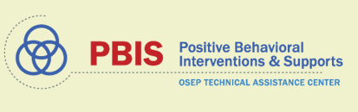
Acknowledgements for this Section
(Co-authors of PBIS Technical Brief on Systems to Support Teachers’ Implementation of Positive Classroom Behavior Support):
Jennifer Freeman
Brandi Simonsen
Steve Goodman
Barbara Mitchell
Heather George
Jessica Swain-Bradway
Kathleen Lane
Jeff Sprague
Bob Putnam

Slide 15
PBIS Technical Brief on Systems to Support Teachers’ Implementation of Positive Classroom Behavior Support

Slide 16
Hyperlink
Guiding Questions

Slide 17
Tables with Details

Slide 18
School-Level Scenario

Slide 19
PCBS Systems Action Planning Guide:
3 Key Questions
Are the foundational systems in place to support PCBS practice implementation by all staff?
Do all staff know what PCBS practices to implement and if they’re doing it accurately?
Do data indicate that staff are implementing PCBS practices effectively?

Slide 20
PCBS Systems Action Planning Guide:
3 Key Questions
Are the foundational systems in place to support PCBS practice implementation by all staff?
Do all staff know what PCBS practices to implement and if they’re doing it accurately?
Do data indicate that staff are implementing PCBS practices effectively?

Slide 21
Are the foundational systems in place to support PCBS practice implementation by all staff?
PCPS implementation is a clear school and district priority
Examples:
District and school administrators have communicated a clear priority for PCBS implementation.
Non-Examples:
No practices are prioritized for implementation, identified strategies lack evidence of effectiveness, and/or priority practices are not effectively disseminated among all staff.

Slide 22
Are the foundational systems in place to support PCBS practice implementation by all staff?
PCPS implementation is a clear school and district priority
+
School and district resources are available to support PCBS implementation
Examples:
Dedicated time for training
Dedicated time for coaching functions
Regular data review
Celebration or recognition of staff implementation
Non-Examples:
No dedicated time or resources
Data not shared or not used in problem solving
Staff recognition not available or used to celebrate PCBS implementation

Slide 23
Are the foundational systems in place to support PCBS practice implementation by all staff?
PCPS implementation is a clear school and district priority
+
School and district resources are available to support PCBS implementation
+
School and district teams have considered alignment and integration of PCBS with other district priorities and initiatives
Examples:
Implementation of PCBS connected to clear need in building
Implementation of PCBS connected to academic instruction
PCBS strategies adapted to ensure classroom contextual and cultural fit
Non-Examples:
Data demonstrating need are not regularly shared
Academic strategies taught in isolation
Training on practices not connected to why it is important in the school

Slide 24
PCBS Systems Action Planning Guide:
3 Key Questions
Are the foundational systems in place to support PCBS practice implementation by all staff?
Do all staff know what PCBS practices to implement and if they’re doing it accurately?
Do data indicate that staff are implementing PCBS practices effectively?
Notes:
Does your school provide additional supports for new teachers? Is there a plan for addressing staff turnover? Is there a way to intensify coaching supports in your school?

Slide 25
Do all staff know what PCBS practices to implement and if they’re doing it accurately?
Clear expectations and explicit training about practices that should be implemented by all staff.
Examples:
Clearly stated outcomes
Explicit (model, lead, test) approach
Job-embedded
  Linked to school data
  Delivered in various contexts and connected to practice
Non-Examples:
PD focuses only on theory and assumes educators will discover practices
Full-day intensive training with no follow-up
Short trainings not connected to larger need, structure, etc.
Notes:
Does your school provide additional supports for new teachers? Is there a plan for addressing staff turnover? Is there a way to intensify coaching supports in your school?

Slide 26
Do all staff know what PCBS practices to implement and if they’re doing it accurately?
Clear expectations and explicit training about practices that should be implemented by all staff.
+
Coaching and/or regularly available performance feedback on the use of PCBS practices?
Examples:
Prompts and reminders
Supportive data-based feedback
Supports may be delivered by
  Coach/mentor
  Peer/peer team
  Self
Non-Examples:
Data delivered in punitive evaluative fashion
Feedback delayed or not data-based
Notes:
Does your school provide additional supports for new teachers? Is there a plan for addressing staff turnover? Is there a way to intensify coaching supports in your school?

Slide 27
Table 2. Coaching

Slide 28
PCBS Systems Action Planning Guide:
3 Key Questions
Are the foundational systems in place to support PCBS practice implementation by all staff?
Do all staff know what PCBS practices to implement and if they’re doing it accurately?
Do data indicate that staff are implementing PCBS practices effectively?

Slide 29
Do data indicate that staff are implementing PCBS practices effectively?
Are staff implementing PCBS with fidelity?
Determine the number of classrooms needing support (many or a few)
Review and adjust universal support
Determine type and severity of implementation changes (minor or major)
Provide supplemental support to small groups of staff needing support
Consider individualized supports and other strategies for staff members needing intensified support.
Well done! Monitor outcomes and adjust as needed
Yes
No
Minor
Major
Many
Few
What data do we use to drive decision making?

Slide 30
Table 3. Data Tools

Slide 31
Multi-tiered Framework of Professional Development Support
Tier 3
Intensive PD: Data-driven Consultation
Tier 2
Targeted PD: Self-Management with Peer or Coaching Supports
Tier 1
Universal PD: Training & Self-Management
Progress Monitoring
Walk-through, Student Data Review, Teacher Collected Data
Universal Screening
Walk-through & Student Data Review
How can we approach intensifying our supports
for educators implementing PCBS?
(adapted from Simonsen, MasSuga, Briere, Freeman, Myers, Scott, & Sugai, 2013)

Slide 32
See Systems Brief

Slide 33
Let’s Discuss Some Examples
As a result of attending today’s training, you will be able to
Describe the need for supporting teachers’ implementation of of positive classroom behavior support (PCBS) practices
Develop systems to support teachers’ implementation of PCBS practices
Discuss a multi-tiered framework of professional development support for teachers; and
Identify promising, efficient, and effective support strategies for teachers’ PCBS practices.

Slide 34

Acknowledgements for this Session
(in Alphabetical Order, with Publication Years):
Don Briere (2013)
Amy Briesch (2008)
Carla DeLuca (2010)
Kate Dooley (under review, in preparation)
Sarah Fairbanks (2008)
Lindsey Fallon (2012)
Jen Freeman (2013, in preparation)
Lola Gordon (in preparation)
Laura Kern (under review, in preparation)
Ashley MacSuga-Gage (2012, 2013, in preparation)
Eleanor Maddock (under review, in preparation)
Diane Myers (2008, 2010, 2013, under review, in preparation)
Terry Scott (2013)
George Sugai (2008, 2012, 2013)

Slide 35
This is one way to start organizing our implementation supports
Context
It:
EBP
Who:
Implementation “Supporters”
How:
Train, prompt, use data
Where:
Teacher / Classroom
We know what these are!
We know where!
But…
?
?
Expert
Self
How often?
Who needs what?
Peer
On what?
(Adapted from Fixsen, Naoom, Blasé, Friedman, & Wallace, 2005, p.12)
Notes:
Fixsen, D. L., Naoom, S. F., Blase, K. A., Friedman, R. M. & Wallace, F. (2005). Implementation Research: A Synthesis of the Literature. Tampa, FL: University
of South Florida, Louis de la Parte Florida Mental Health Institute, The National Implementation Research Network (FMHI Publication #231).

Slide 36
Multi-tiered Framework of Professional Development Support
EXAMPLES
Tier 3
Intensive PD: Data-driven Consultation
Tier 2
Targeted PD: Self-Management with Peer or Coaching Supports
Tier 1
Universal PD: Training & Self-Management
Progress Monitoring
Walk-through, Student Data Review, Teacher Collected Data
Universal Screening
Walk-through & Student Data Review
Self-management may be ONE way to approach this!
(adapted from Simonsen, MasSuga, Briere, Freeman, Myers, Scott, & Sugai, 2013)

Slide 37
Self Management: A promising component of effective and efficient PD support
Self-management: Individuals manage their own behavior in the same manner as they manage anyone else’s—“through the manipulation of variables of which behavior is a function” (Skiner, 1953, p. 228).
  Self-manipulation of antecedents
  Engaging in other (self-management) behaviors to affect probability of target behaviors
  Self-monitoring and self-evaluation
  Self-manipulation of consequences (e.g., self-reinforcement)
Notes:
Self-management interventions
are related to desired behavior changes in adults who are obese, have asthma, have depression, and experience insomnia
(Caplin & Creer, 2001; Creer, Caplin, & Holroyd, 2005; Creti, Libman, Bailes, & Frichman, 2005; Ngamvitroj & Kang, 2007Donaldson & Norman, 2009; Rokke, Tomhave, & Jocic, 2000)
result in better instructional decisions
(Allinder, Bolling, Oats, &Gagnon, 2000; Liberty, Heller, & D’Huyvetters, 1986)
result in increases in teachers’ use of praise
(Keller, Brady, & Taylor, 2005; Sutherland & Wehby, 2001; Workman, Watson, & Helton, 1982).

Slide 38

What does our initial research on self-management indicate?
Across three studies, we’ve found that self-management with email coaching prompts resulted in desired initial increases in specific classroom management skills across teachers. We are still working to enhance maintenance and generalization of effects.
(Simonsen, Freeman, Dooley, Maddock, & Kern, 2017)
  Teachers…
  Set a goal (criterion for self-reinforcement)
  Self-monitored daily
  Entered data into an Excel Spreadsheet, which automatically graphed daily praise rates relative to goal
  Self-evaluated and self-reinforced
  Received weekly email prompts to use specific praise and submit data

Slide 39

Where can you find the materials?
See classroom tab of nepbis.org for copies of the training scripts, email prompts, and spreadsheets we’ve developed for tracking
praise,
prompts, and
opportunities to respond.

Slide 40
Supporting Teachers with Targeted PD

Slide 41
Implementing Targeted Professional Development (PD)
Targeted PD may work as tier 1 or 2 PD support for teachers.
May be facilitated by a school-based behavior coach, instructional coach, or other school leader with behavioral expertise.

Slide 42
Targeted PD Includes
Brief didactic training (1:1 or group setting)
Teacher/staff self-management:
  Daily self-monitoring during brief (15 min) sample of instruction
  Daily self-evaluation (entering data, determining if goal was met)
  Self-reinforcement (celebrating on days when goal is met)
Weekly email reminders re: skill use and self-management strategies (by behavior coach)
Periodic (e.g., bi-weekly) “fidelity monitoring” of skill use and self-management (by behavior coach)

Slide 43
Didactic Training
Scripted training that provides:
  Definition of skill
  Rational for using the skill
  Examples/non-examples of the skill
  Activity to apply the skill in the natural context
  Definition of self-management
  Instruction in self-management (i.e., how to self-monitor, enter data, self-evaluate, and self-reinforce)
See example for specific praise in your handout and previewed next.

Slide 44
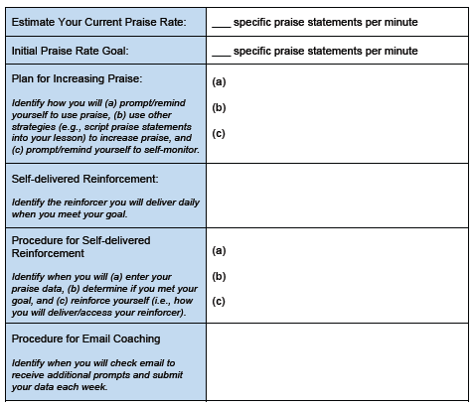
Develop Self-management Plan
See example for specific praise in your handout.

Slide 45
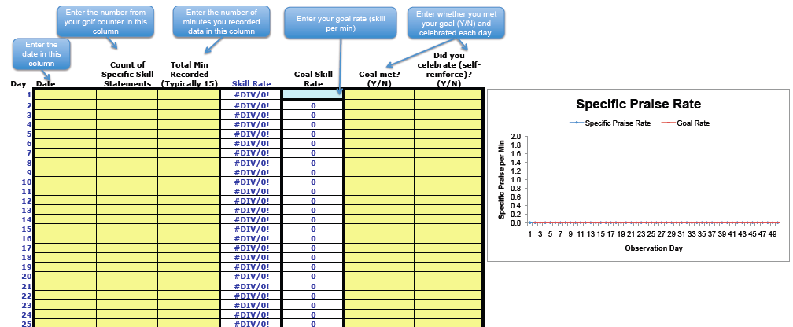
Use Self-management
Self-monitor
Use spreadsheet to enter data and self-evaluate
Self-reinforce
See examples on “classrooms” tab at nepbis.org.

Slide 46
Weekly Email Reminders
Brief email reminders about praise and skill use.
For example:
  Remember, specific praise is contingent (delivered immediately after the behavior), specific (names the desired behavior exhibited), and positive.
  ‘Nice hand raise’ and ‘Thank you for actively listening’ are examples of brief specific praise statements.
  Keep on counting, graphing, reviewing your data, and reinforcing yourself when you meet your goal!

Slide 47
Multi-tiered Framework of Professional Development Support
EXAMPLES
Tier 3
Intensive PD: Data-driven Consultation
Tier 2
Targeted PD: Self-Management with Peer or Coaching Supports
Tier 1
Universal PD: Training & Self-Management
Progress Monitoring
Walk-through, Student Data Review, Teacher Collected Data
Universal Screening
Walk-through & Student Data Review
Coaching/Mentoring may be ANOTHER way to approach this!
Self-management may be ONE way to approach this!
(adapted from Simonsen, MasSuga, Briere, Freeman, Myers, Scott, & Sugai, 2013)

Slide 48
What about other approaches?
Consultation approaches may provide intensive supports for new or in-service teachers.
(Briere, Simonsen, Myers, & Sugai, 2015; MacSuga & Simonsen, 2011)
  Another Research Example…
  Don Briere explored the effects of within-school consultation (self-monitoring + structured weekly meetings) on the specific praise rates of 3 new (induction) elementary school teachers

Slide 49
Multi-tiered Framework of Professional Development Support
EXAMPLES
Tier 3
Intensive PD: Data-driven Consultation
Tier 2
Targeted PD: Self-Management with Peer or Coaching Supports
Tier 1
Universal PD: Training & Self-Management
Progress Monitoring
Walk-through, Student Data Review, Teacher Collected Data
Universal Screening
Walk-through & Student Data Review
Peer Supports may be ANOTHER way to approach this!
Self-management, coaching, and/or mentoring may be ways to approach this!
(adapted from Simonsen, MasSuga, Briere, Freeman, Myers, Scott, & Sugai, 2013)

Slide 50
In sum, this is one way to provide implementation supports
Context
It:
EBP
Who:
Implementation “Supporters”
How:
Train, prompt, use data
Where:
Teacher / Classroom
We know what these are!
We know where!
Expert
Self
How often?
Brief training
Who needs what?
Daily data feedback
Peer
On what?
Weekly email prompts
(Adapted from Fixsen, Naoom, Blasé, Friedman, & Wallace, 2005, p.12)
Notes:
Fixsen, D. L., Naoom, S. F., Blase, K. A., Friedman, R. M. & Wallace, F. (2005). Implementation Research: A Synthesis of the Literature. Tampa, FL: University
of South Florida, Louis de la Parte Florida Mental Health Institute, The National Implementation Research Network (FMHI Publication #231).

Slide 51
Multi-tiered Framework of Professional Development Support
Tier 3
Intensive PD: Data-driven Consultation
Tier 2
Targeted PD: Self-Management with Peer or Coaching Supports
Tier 1
Universal PD: Training & Self-Management
Progress Monitoring
Walk-through, Student Data Review, Teacher Collected Data
Universal Screening
Walk-through & Student Data Review
We believe this approach (among others) may be best delivered within a multi-tiered framework for PD.
(adapted from Simonsen, MasSuga, Briere, Freeman, Myers, Scott, & Sugai, 2013)

Slide 52
Key Take Away Messages
Invest in systems to support teachers’ implementation of PCBS practices.
PD supports organized in a multi-tiered framework may facilitate teachers’ implementation of PBIS practices.
Self-management may be a helpful PD support within a MTF

Slide 53
Organizing Supports within an MTS Framework

Slide 54
Supporting Social Competence &
Academic Achievement
4 PBIS Elements
OUTCOMES
Supporting
Decision
Making
Supporting
Staff Behavior
SYSTEMS
DATA
PRACTICES
Supporting
Student Behavior

Slide 55
Supporting Social Competence &
Academic Achievement
What outcomes do you have for CWPBIS in your school? in your district?
OUTCOMES
What do these look like across tiers 1, 2, and 3?
Are these reflected in the action plan(s) for your school? for your district?

Slide 56
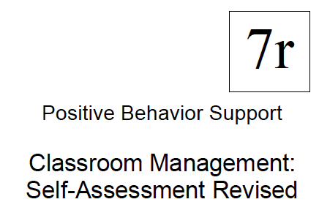
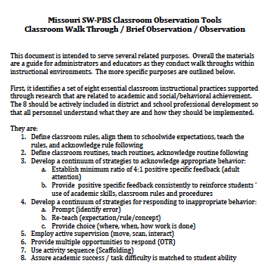
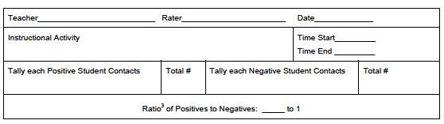
What data will you collect to (a) evaluate CWPBIS, (b) identify teachers who need support, and (c) progress monitor?
SWIS
DATA
Checklists
Supporting
Decision
Making
Walk Through
Are these data reflected in the action plan(s) for your school? for your district?
Self-Monitoring
Direct Observation
What does this look like across tiers 1, 2, and 3?

Slide 57
Maximize structure in your classroom.
Post, teach, review, monitor, and reinforce a small number of positively stated expectations.
Actively engage students in observable ways.
Establish a continuum of strategies to acknowledge appropriate behavior.
Establish a continuum of strategies to respond to inappropriate behavior.
PRACTICES
Supporting
Student Behavior

Slide 58
Traditional PD
SYSTEMS
Self-Management
Supporting
Staff Behavior
Antecedent
Behavior
Consequence
Coaching/Consultation
Prompts
Monitor
Reinforce
Antecedent
Behavior
Consequence
Changes to Environ
Correct

Slide 59


Tier 3: Individualized Consultation Supports
Tier 2: Self-Management (Self-Monitoring, Self Eval, Self S^{R+}), Prompts, & Accountability
Tier 1: Overview of Classroom Management Practices (Explicit Training) & Self-Monitoring
Secondary Screening: Unresponsive to Tier 2 or Challenges across X skills
Universal Screening: Walk-through, ODR data, CBM data
Maximize structure in your classroom.
Post, teach, review, monitor, and reinforce a small number of positively stated expectations.
Actively engage students in observable ways.
Establish a continuum of strategies to acknowledge appropriate behavior.
Establish a continuum of strategies to respond to inappropriate behavior.
(Simonsen, first use August 2011)

Slide 60
Taking Practices to Scale: Discussion

Slide 61
In addition to the strategies we’ve tried in research…
…many schools have been busy trying to figure out how to
  Increase teachers’ use of classroom management skills
  Assess classroom management
  Support new teachers and teachers with significant challenges
Lets discuss a few more examples, and then you’ll have time to “jigsaw” to identify additional strategies”

Slide 62
Other examples…
Principal reviews 1 strategy per faculty meeting and gives grade-level (or content-specific) teams time to action plan around incorporating the strategy into their classrooms.
Dean of Students has teachers read a book on classroom management (e.g., Geoff Colvin’s book) and provides explicit training on each strategy (with CEUs).
School arranges peer mentors for all new or struggling teachers. Mentors model and then provide coaching and feedback.

Slide 63
Other examples…
A consultant teaches one strategy (e.g., praise) and asks teachers to self-monitor their use of that strategy during 1 instructional activity per day for 4 weeks. Teachers share praise rates in professional learning communities to support each others’ practice.
PBS team members present content on classroom management (e.g., matrix, lesson plans, etc.). Then, they hold “workshop” drop in hours—when teachers can come get assistance with creating their products.

Slide 64
Wrap-up

Slide 65
Recap: Evidence Based Practices in Classroom Management
Maximize structure in your classroom.
Post, teach, review, monitor, and reinforce a small number of positively stated expectations.
Actively engage students in observable ways.
Establish a continuum of strategies to acknowledge appropriate behavior.
Establish a continuum of strategies to respond to inappropriate behavior.
(Simonsen, Fairbanks, Briesch, Myers, & Sugai, 2008)

Slide 66
Decision-making Guide: 3 Key Questions
Are the foundations of effective CPBIS in place?
Effectively design the physical environment of the classroom
+
Develop & teach predictable classroom routines.
+
Post, define, & teach 3-5 positive classroom expectations.
Are proactive and positive CPBIS practices implemented consistently?
Provide high rates of varied opportunities to respond.
+
Use prompts and active supervision.
+
Acknowledge behavior with specific praise & other strategies.
Do data indicate that students are still engaging in problem behavior?

Slide 67
Are students still engaging in problem behavior?
Are behaviors minor or major expectation violations?
Well done! Monitor outcomes and adjust as needed
Use brief, specific error correction & other strategies
How many students are involved (many or few)?
Review, adjust & intensify CWPBIS. Ask for help!
Request additional (tier 2 & 3) support for students.
Yes
No
Minor
Major
Do data indicate that students are still engaging in problem behavior?
Many
Few

Slide 68
PCBS Systems Action Planning Guide:
3 Key Questions
Are the foundational systems in place to support PCBS practice implementation by all staff?
PCPS implementation is a clear school and district priority
+
School and district resources are available to support PCBS implementation
+
School and district teams have considered alignment and integration of PCBS with other district priorities and initiatives
Do all staff know what PCBS practices to implement and if they’re doing it accurately?
Clear expectations and explicit training about practices that should be implemented by all staff
+
Coaching and/or regularly available performance feedback on the use of PCBS practices
Do data indicate that staff are implementing PCBS practices effectively?

Slide 69
Are staff implementing PCBS with fidelity?
Determine the number of classrooms needing support (many or a few)
Review and adjust universal support
Determine type and severity of implementation changes (minor or major)
Provide supplemental support to small groups of staff needing support
Consider individualized supports and other strategies for staff members needing intensified support.
Well done! Monitor outcomes and adjust as needed
Yes
No
Minor
Major
Many
Few
Do data indicate that staff are implementing PCBS practices effectively?

Slide 70

Remember Your Resources
Supporting and Responding to Student Behavior
Classroom Management Practice Checklists
PBIS Technical Brief on Systems to Support Teachers’ Implementation of Positive Classroom Behavior Support
Action Plan

Slide 71
Thank you!
brandi.simonsen@uconn.edu
www.pbis.org
www.cber.org

