Slide 1


Creating a Positive and Proactive Classroom to Support ALL Learners
Brandi Simonsen, Ph.D.
Notes:
The title of this year’s Institute is - Personalizing Education: Innovative, Multi-Tiered Pathways to Social and Academic Success.

Slide 2
Workshop Overview
Mon (9:30-12:30) | Class-wide Antecedent and Teaching Behavior Strategies Maximizing Structure, Classroom Expectations, & Active Engagement
Tue (9:30-12:30) | Class-wide Consequence Strategies Acknowledging Appropriate and Responding to Inappropriate Behavior
Wed (9:45-12:30) | Positive and Proactive Supports for ALL and Action Planning Applying Knowledge of Strategies to An Individual Classroom
Thurs (8:45-10:00, 10:30-12:30) | Developing Systems to Support Class-wide Support Taking your knowledge to scale (from one classroom to all classrooms)

Slide 3
Advance Organizer: Day 1
9:30-9:45 | Introductions & Overview
9:45-10:15 | Lecture & Discussion: Critical Features Part 1 1. Maximizing structure 2a. Establishing expectations
10:15-10:45 | Table Activity: Class-wide Rules-within-Routines Matrix Develop a sample class-wide matrix
10:45-11:00 | BREAK
11:00-11:30 | Lecture & Discussion: Critical Features Part 2 2b. Teaching, prompting, monitoring, & evaluating expectation-following behavior
11:30-12:00 | Table Activity: Social Skills Lesson Plan Develop a sample social skills lesson plan
12:00-12:15 | Lecture & Discussion: Critical Features Part 3 3. Actively engaging students
12:15-12:30 | Wrap-up Review and look toward tomorrow

Slide 4
Critical Features of
Positive and Proactive Classroom Management
PART 1: Antecedent and Teaching Strategies (Steps 1-3)

Slide 5
Acknowledgements for this portion:
Other Members of Research Team:
Sarah Fairbanks, Amy Briesch, Diane Myers, & George Sugai
www.pbis.org
www.cber.org

Slide 6
SWPBS
Systems
School-wide
Classroom
Non-classroom
Family
Student

Slide 7

What “kind” of students can display problematic behavior?
All students. Students with/without labels who are served in general/special education can display problematic behavior.
This is not a special education issue. It is an education issue.
We need to learn more about
the 5 critical features of
effective classroom management
to be able to help all students.

Slide 8
Evidence Based Practices in Classroom Management
Maximize structure in your classroom.
Post, teach, review, monitor, and reinforce a small number of positively stated expectations.
Actively engage students in observable ways.
Establish a continuum of strategies to acknowledge appropriate behavior.
Establish a continuum of strategies to respond to inappropriate behavior.
(Simonsen, Fairbanks, Briesch, Myers, & Sugai, 2008)

Slide 9
Class-wide Antecedent
& Teaching Strategies
(Steps 1-3)

Slide 10
1. Maximize structure in your classroom.
Develop Predictable Routines
  Teacher routines
  Student routines
Design environment to (a) elicit appropriate behavior and (b) minimize crowding and distraction:
  Arrange furniture to allow easy traffic flow.
  Ensure adequate supervision of all areas.
  Designate staff & student areas.
  Seating arrangements (groups, carpet, etc.)

Slide 11
2. Post, Teach, Review, Monitor, and reinforce a small number of positively stated expectations.
Establish
Teach
Prompt
Monitor
Evaluate
Notes:
Sarah

Slide 12
Establish
Behavioral expectations/Rules
A small number (i.e., 3-5) of positively stated rules. Tell students what we want them to do, rather than telling them what we do not want them to do.
Why “small number”?

Slide 13
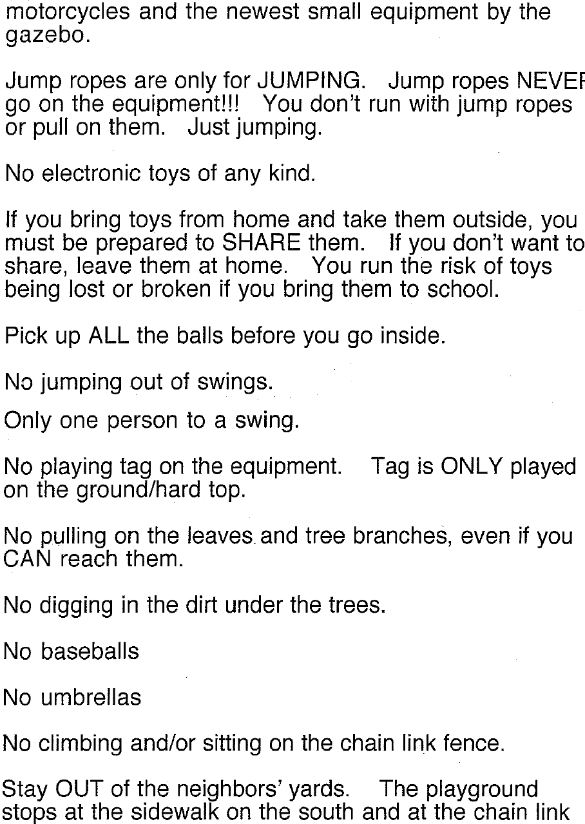
Whatcha think?

Slide 14
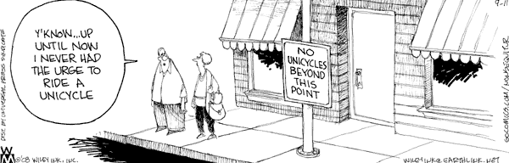
Why positive?

Slide 15
Establish
Behavioral expectations/Rules
A small number (i.e., 3-5) of positively stated rules. Tell students what we want them to do, rather than telling them what we do not want them to do.
Publicly post the rules.
Should match SW Expectations

Slide 16
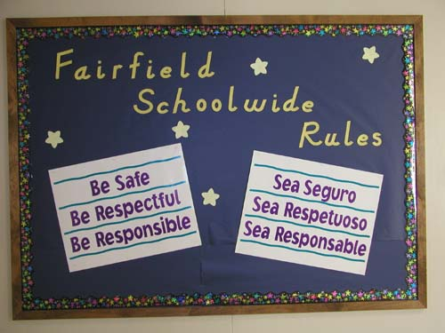

Slide 17
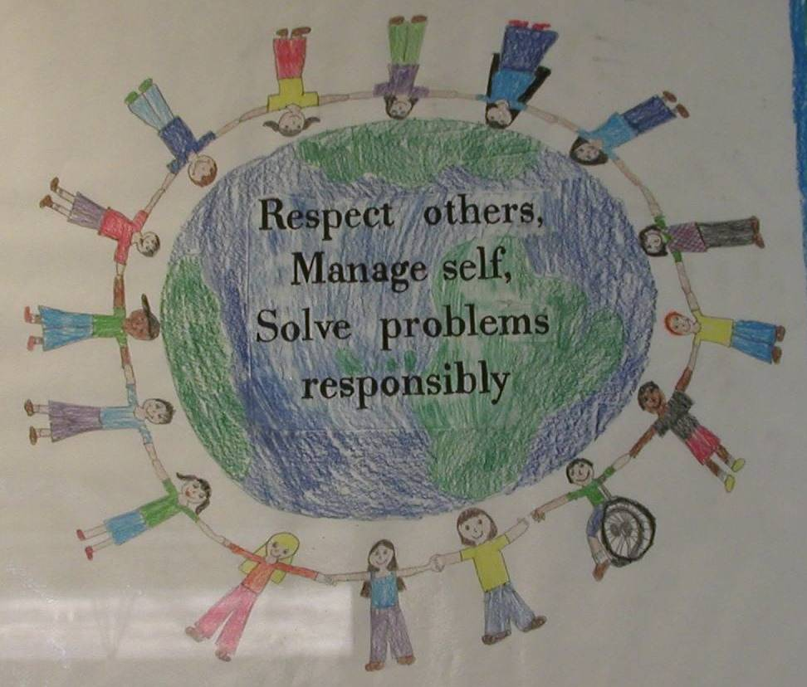

Slide 18
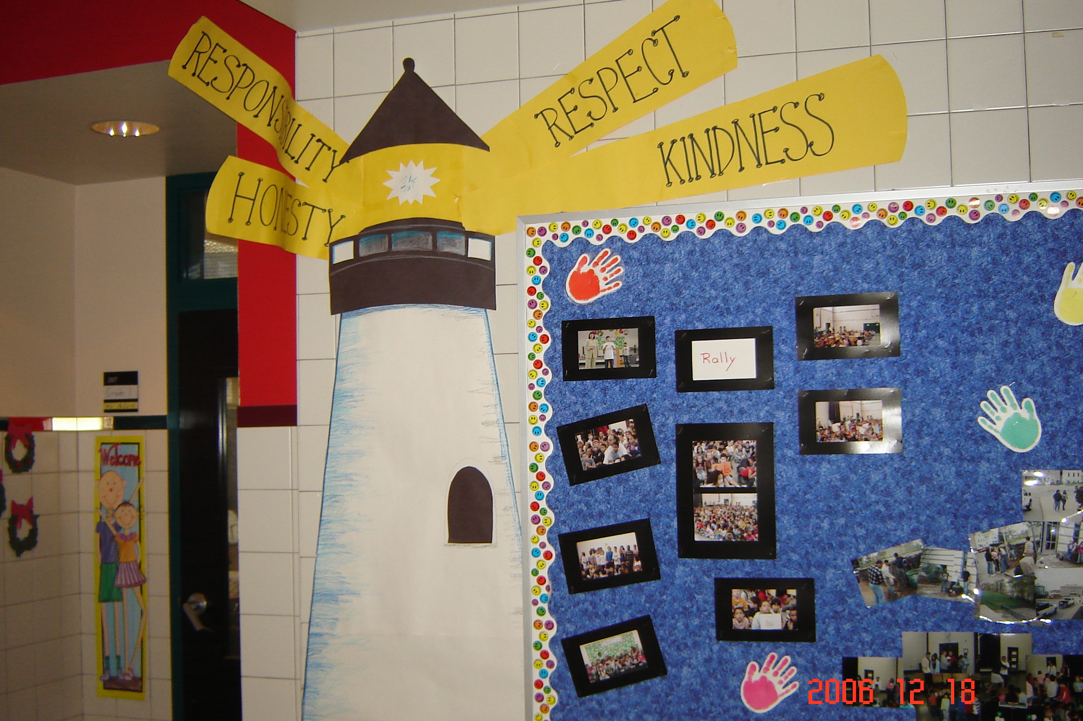
City View School, MA
New England puts a unique spin on things!

Slide 19
Establish
Behavioral expectations/Rules
Operationally define what the rules look like across all the routines and settings in your school.
One way to do this is in a matrix format.
This matrix should compliment your school-wide matrix, but be specific to your classroom setting.

Slide 20
Rules within Routines Matrix
Routines Rules | Entering Classroom | Seat Work | Small Group Activity | Leaving Classroom
Respect
Responsibility
Safety

Slide 21
Teach
rules in the context of routines
Teach expectations directly.
  Define rule in operational terms—tell students what the rule looks like within routine.
  Provide students with examples and non-examples of rule-following within routine.
Actively involve students in lesson—game, role-play, etc. to check for their understanding.
Provide opportunities to practice rule following behavior in the natural setting.

Slide 22
“Cool Tool”
Skill Name
Getting Help (How to ask for assistance for difficulty tasks)
Teaching Examples
1. When you’re working on a math problem that you can’t figure out, raise your hand and wait until the teacher can help you. 2. You and a friend are working together on a science experiment but you are missing a piece of lab equipment, ask the teacher for the missing equipment. 3. You are reading a story but you don’t know the meaning of most of the words, ask the teacher to read and explain the word.
Kid Activity
1. Ask 2-3 students to give an example of a situation in which they needed help to complete a task, activity, or direction. 2. Ask students to indicate or show how they could get help. 3. Encourage and support appropriate discussion/responses. Minimize attention for inappropriate responses.
After the Lesson (During the Day)
1. Just before giving students difficult or new task, direction, or activity, ask them to tell you how they could get help if they have difficulty (precorrection). 2. When you see students having difficulty with a task (e.g., off task, complaining), ask them to indicate that they need help (reminder). 3. Whenever a student gets help the correct way, provide specific praise to the student.

Slide 23
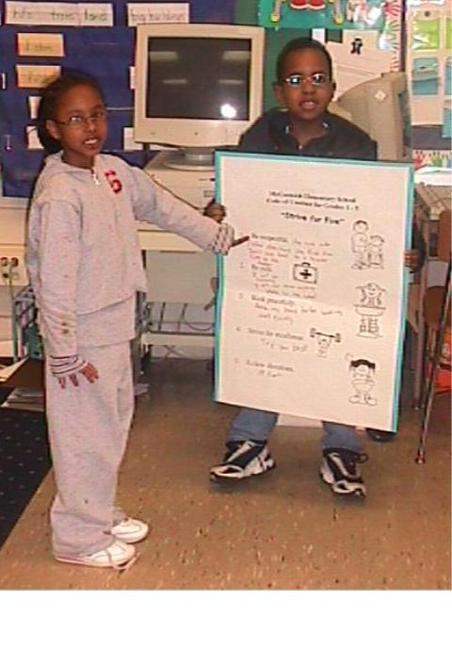
Reviewing Strive for Five
Be respectful.
Be safe.
Work peacefully.
Strive for excellence.
Follow directions.
McCormick Elem. MD 2003

Slide 24
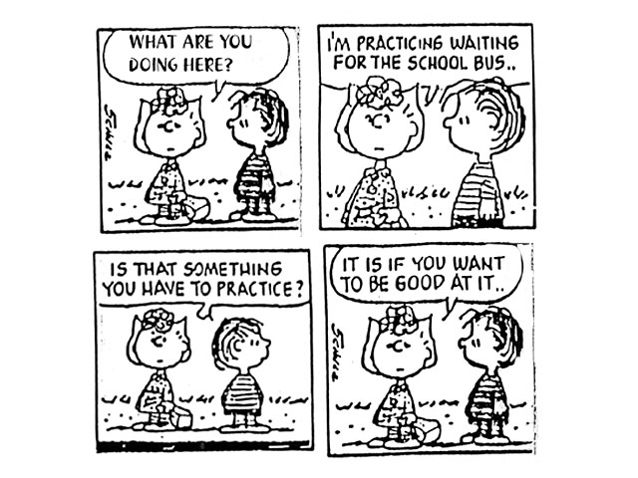
Teach
rules in the context of routines

Slide 25
Prompt
or remind students of the rule
Provide students with visual prompts (e.g., posters, illustrations, etc).
Use pre-corrections, which include “verbal reminders, behavioral rehearsals, or demonstrations of rule-following or socially appropriate behaviors that are presented in or before settings were problem behavior is likely” (Colvin, Sugai, Good, Lee, 1997).

Slide 26
Monitor
students’ behavior in natural context
Active Supervision (Colvin, Sugai, Good, Lee, 1997):
            Move around
            Look around (Scan)
            Interact with students
                Reinforce
                Correct

Slide 27
Evaluate
the effect of instruction
Collect data
  Are rules being followed?
  If there are errors,
    who is making them?
    where are the errors occurring?
    what kind of errors are being made?
Summarize data (look for patterns)
Use data to make decisions

Slide 28
Creating your own lesson plan
Develop scripted lesson plans
A separate lesson plan should be developed for teaching each expectation in the context of each routine.
That is, a separate lesson would be created for each box in the matrix.

Slide 29
Lesson plans should include:
a brief explanation of the expectation and routine,
a statement (i.e., operational definition) of what it looks like to follow the expectation within the routine, including both positive and negative teaching examples;
a demonstration of expectation-following behavior (model),
activities that provide students with guided practice (lead), and
opportunities for students to independently demonstrate expected behavior in the natural context (test).

Slide 30
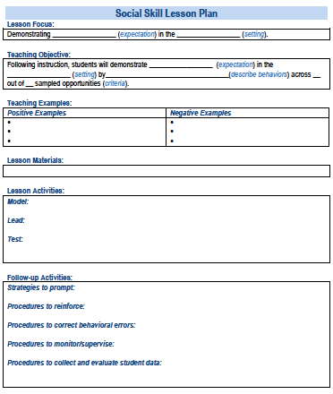
A lesson plan that prompts the critical features just described:
Simonsen, Myers, Everett, Sugai, Spencer, & LaBreck (2012)
Notes:
Explicitly teaching social skills school-wide: Using a matrix to guide instruction. Intervention in School and Clinic, 47, 259-266. doi: 10.1177/1053451211430121

Slide 31
2. RECAP: Post, Teach, Review, Monitor, and reinforce a small number of positively stated expectations.
Establish
Teach
Prompt
Monitor
Evaluate
Notes:
Sarah

Slide 32
3. Actively engage students in observable ways.
Provide high rates of opportunities to respond
Consider various observable ways to engage students
Link engagement with outcome objectives

Slide 33
Range of evidence based practices that promote active engagement
Direct Instruction
Computer Assisted Instruction
Class-wide Peer Tutoring
Guided notes
Response Cards

Slide 34
Wrap-up of Day 1
& Look Toward Day 2

Slide 35
Recap: Evidence Based Practices in Classroom Management
Maximize structure in your classroom.
Post, teach, review, monitor, and reinforce a small number of positively stated expectations.
Actively engage students in observable ways.
Establish a continuum of strategies to acknowledge appropriate behavior.
Establish a continuum of strategies to respond to inappropriate behavior.
(Simonsen, Fairbanks, Briesch, Myers, & Sugai, 2008)

Slide 36
Thank you!
brandi.simonsen@uconn.edu
www.pbis.org
www.cber.org

